Slide 1
AFAANZ 2018 Conference
BB68: Monday Breakfast Panel Session
Remarks by Philip Brown

Slide 2
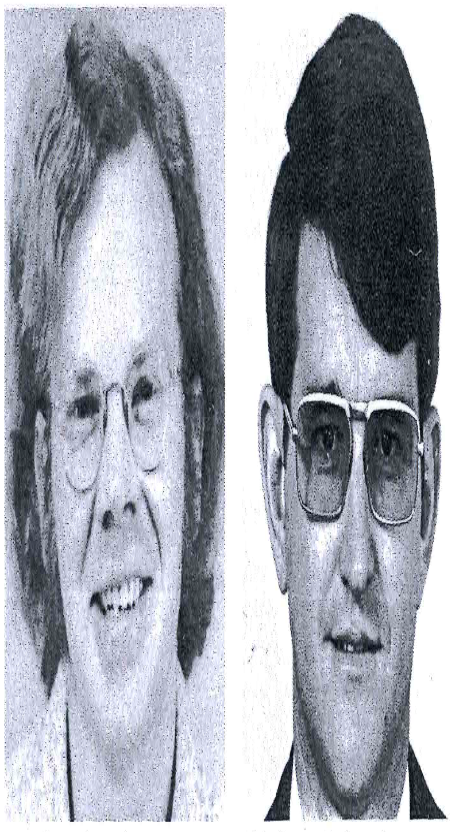
We were younger then (in mid-1968 Ray was 23, Phil 28); by the time we were both at the AGSM we did look older!

Slide 3
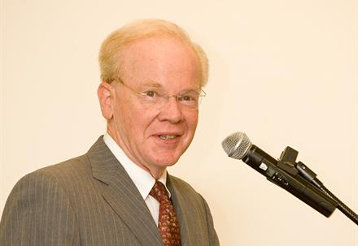
And today?
I’m here so you can see what I look like!
Here’s a more recent photo of Ray (taken not that long ago; source is UNSW website)

Slide 4
Good News
Key
variable 1: Net Income (Mkt Model)
variable 2: EPS (Mkt Model)
variable 3: EPS (RW model)
Bad News
Source: Ball & Brown (1968)
4
Notes:
Here’s Figure 1… most will be familiar with F1 (if you’re not, shame on you!)
Good/Bad news, based on sign of what we called the “forecast error”. [Comment on Beaver 1968?]
Method assumes perfect foresight of earnings/net income 12 months before the annual announcement. Range was from end of month -12 to end of month +6
3 variables
Mkt model: NI and EPS; similar to FFJR’s “market model” in returns
RW model: EPS “surprise” is the change from the previous year

Slide 6
☺☺

