Slide 1
MEET THE EDITORS PANEL
AFAANZ 2018 MONDAY 2 JULY

Slide 4
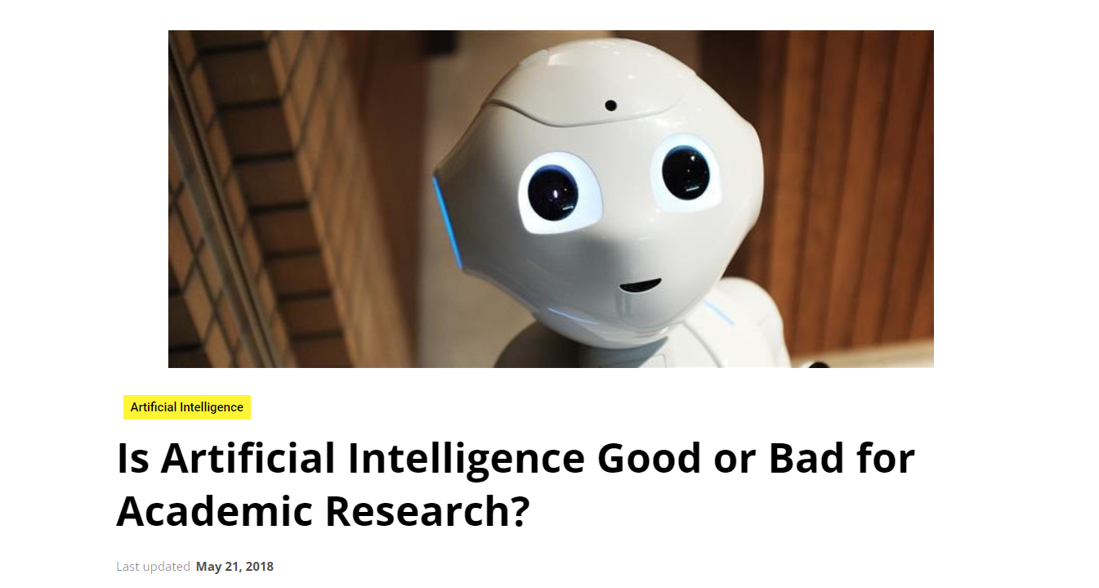
https://www.enago.com/academy/academic-publishing-machine-learning-era/

Slide 5
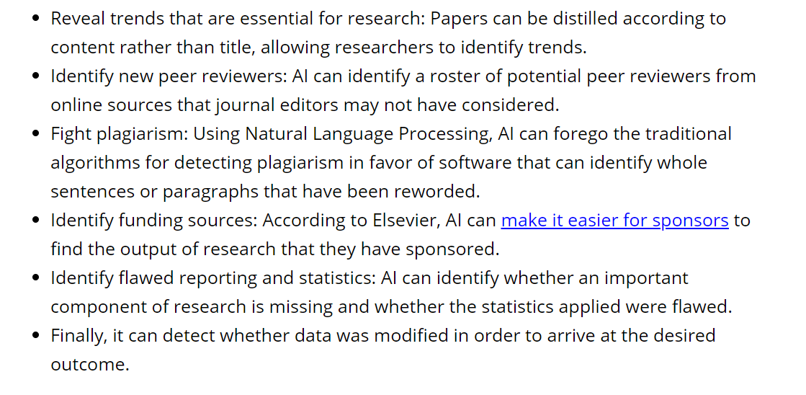
WHY DO WE NEED PEOPLE WHEN AI CAN:

Slide 6
The people factor
submission
Author team
Editorial team
References citations
Impact & engagement
Reviewers

Slide 7
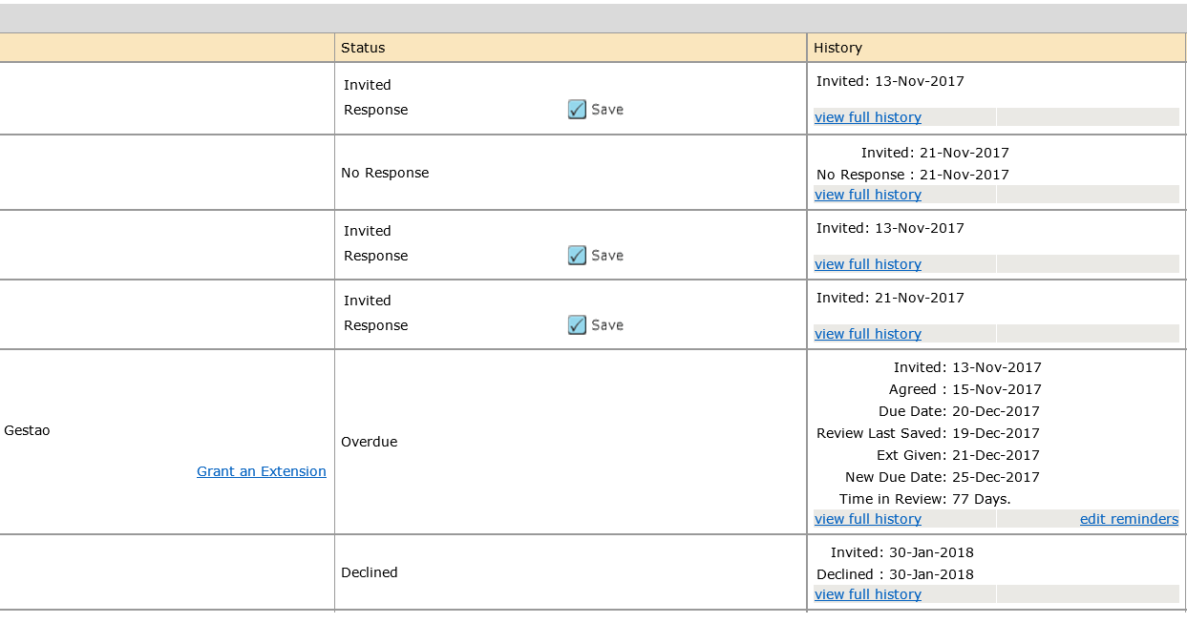
Reviewer List

