Slide 1
50th Anniversary Ball & Brown 1968
AFAANZ Annual Conference
Bryan Howieson
July, 2018

Slide 2
Journal of Accounting Research, 1968, 6(2), pp. 159 – 178.

Slide 3
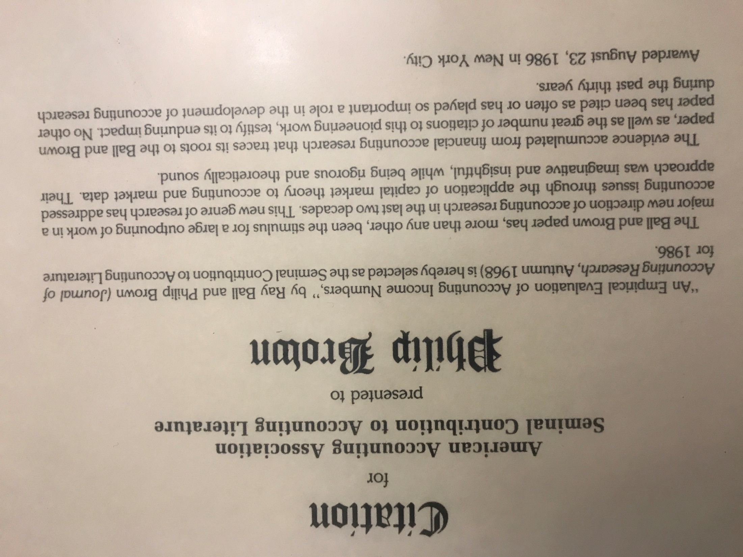

Slide 4
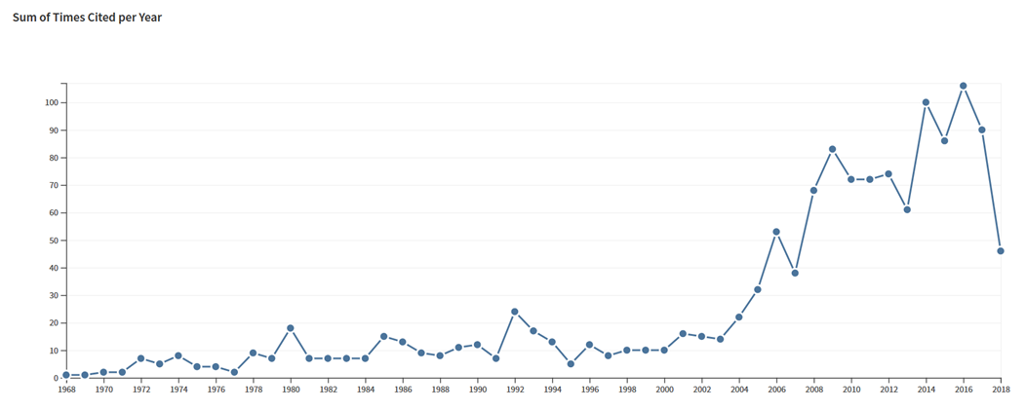
Ball and Brown 1968 Citations in Scholarly Journals Per Year
Source: Web of Science, June, 2018

Slide 5
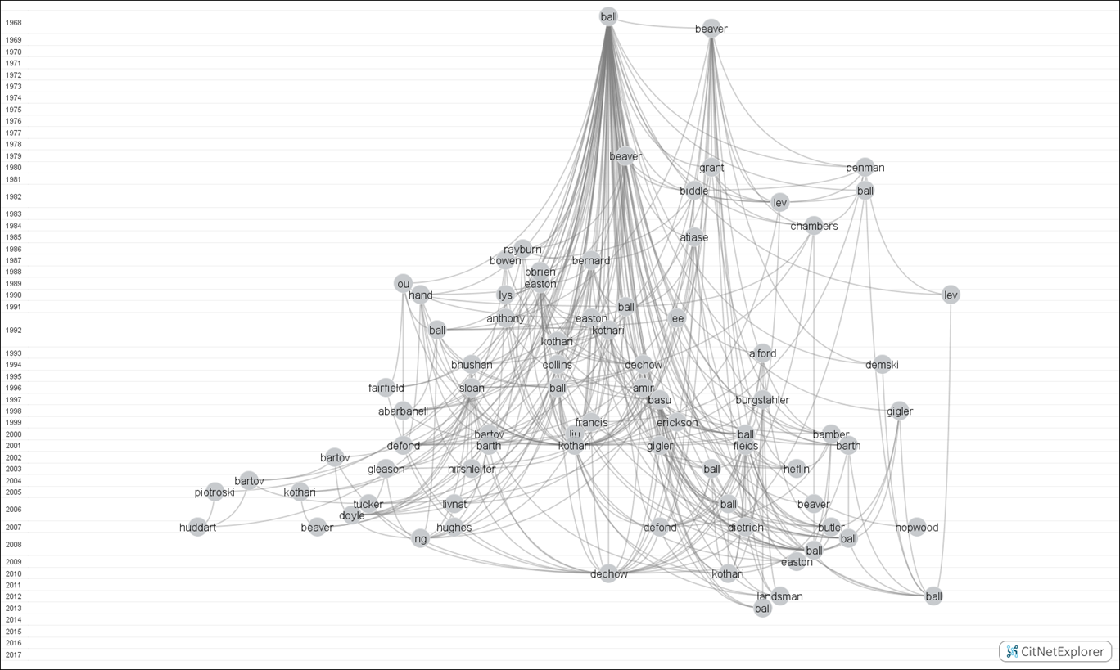
N. Fargher and M. Wee, 2018
First Generation Linkages from Ball and Brown (1968)
Note: Data comprises publications and references from 12 accounting journals from 1968 – 2017.

Slide 6
The Accepted Wisdom …
“Accounting numbers are meaningless”
“No systematic relation between stock prices and any variable, let alone earnings”
BUT what’s the evidence ….?

Slide 7
The Findings
The Famous “Figure 1”
Earnings “useful”
But not timely
Post-earnings announcement drift

Slide 8
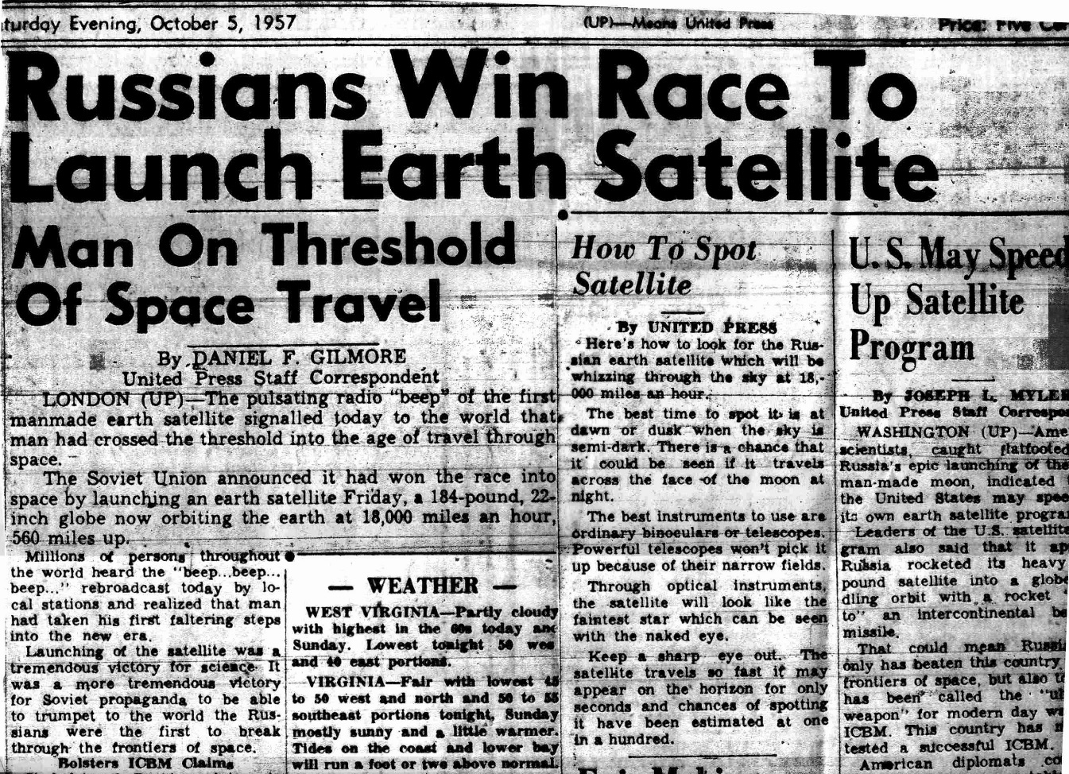

Slide 9
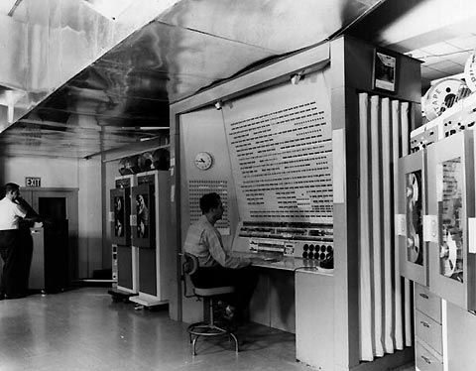
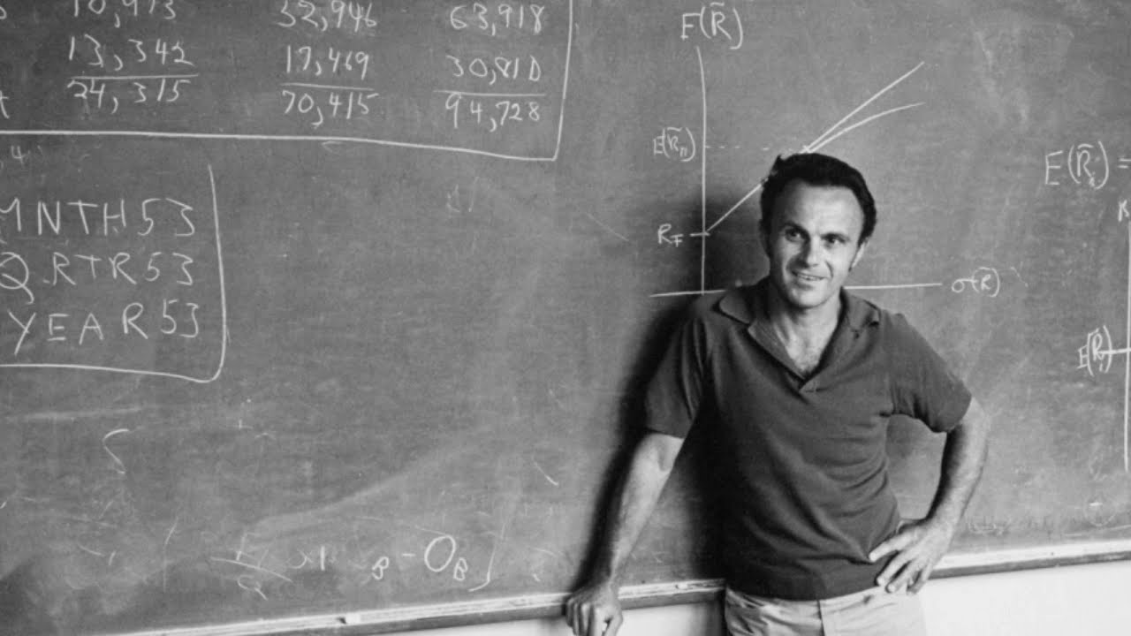

Slide 10
Publication – a near thing …
vs
‘It’s not accounting’
‘Publish and be damned’

Slide 11
Impact
Methodological:
Scientific method
Positive accounting theory
Spread to various sub-disciplines in accounting
Method:
Helped introduce the ‘event study’ to accounting
Knowledge:
Challenged accepted wisdom

Slide 12
Paradise Lost? A Cautionary Tale
“Have Ball and Brown (1968) … had too much influence on the research agenda to the point where other questions and methods are being overlooked?”
(P. Brown, 2013, p. 859)

Slide 13
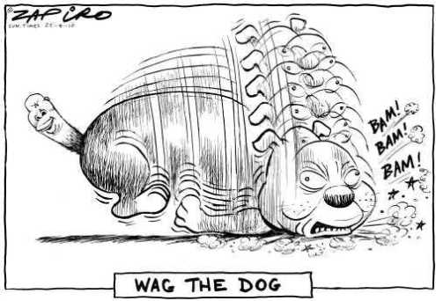
Paradise Lost? A Cautionary Tale
Imitators of BB68 have:
forgotten our history.
data availability dominates research questions.
https://fabiusmaximus.com/2015/01/31/us-marine-corps-manpower-budget-cuts-77548/

Slide 14
An interviewee’s assessment of the legacy of Ball and Brown 1968:
“ I think that [Ball and Brown ‘68] inspired so many people. It inspired me to become a researcher. That was the one paper where I just looked at it and said, ‘this is magic, this is absolute magic!’. I could get it, I could see it as important and I wanted to do that. And that was the only paper of all the papers that I studied which had that effect on me ... the fact that they get the kudos of it is richly deserved because … they actually care. This wasn’t a game, a publishing game to just produce a paper to get tenure, this was actually about changing the way that we do research and they succeeded in that dramatically.”

Slide 15
AFAANZCongratulates

