Slide 1
Data analytics in the accounting classroom
David Bond
UTS Business School

Slide 2
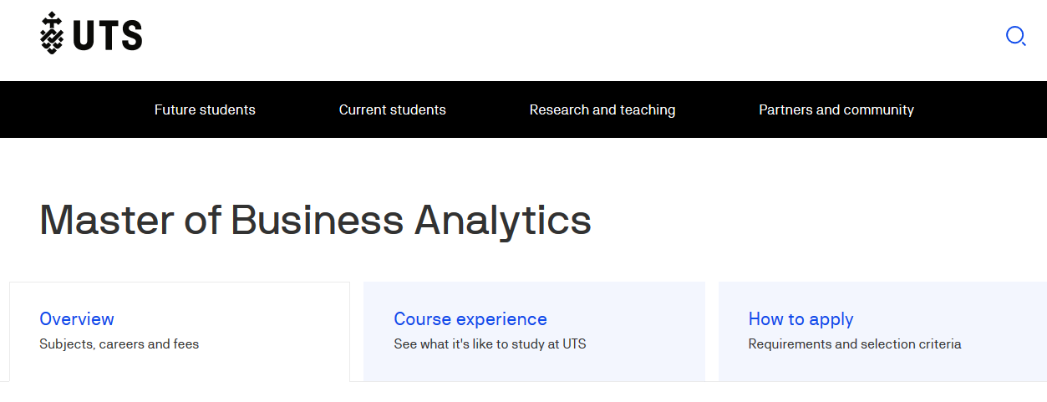

Slide 3
The world is changing
Delete this blue circle and click icon to insert your image. See instructions on Slide 18
Delete this blue circle and click icon to insert your image. See instructions on Slide 18
Delete this blue circle and click con to insert your image. See instructions on Slide 18
Data
The amount of data being generated is massive, and increasingly rapidly
Automation
Human tasks are being automated in a variety of contexts
Partners
“What the organisation is really looking for from accountants or finance staff is to give insights into the business that can help improve decisions.”
Aaron McEwan, Gartner

Slide 4
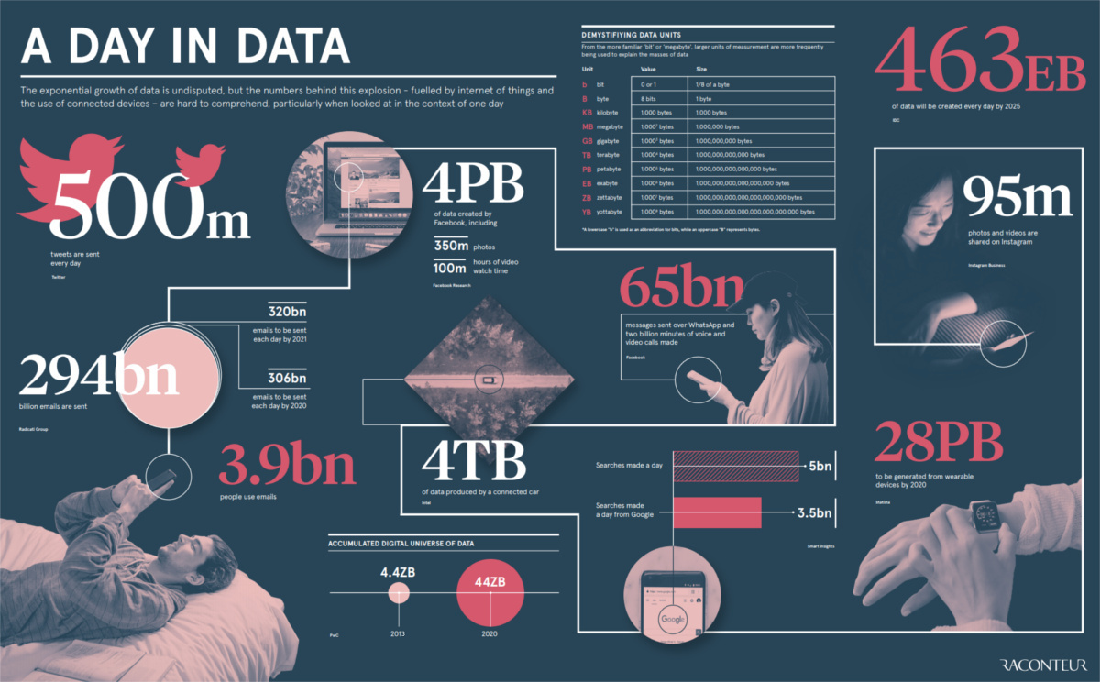
Delete this blue circle and click icon to insert your image. See instructions on Slide 18
Delete this blue circle and click icon to insert your image. See instructions on Slide 18
Delete this blue circle and click con to insert your image. See instructions on Slide 18

Slide 5
The world is changing
Delete this blue circle and click icon to insert your image. See instructions on Slide 18
Delete this blue circle and click icon to insert your image. See instructions on Slide 18
Delete this blue circle and click con to insert your image. See instructions on Slide 18
Data
The amount of data being generated is massive, and increasingly rapidly
Automation
Human tasks are being automated in a variety of contexts
Partners
“What the organisation is really looking for from accountants or finance staff is to give insights into the business that can help improve decisions.”
Aaron McEwan, Gartner

Slide 6
Volvo Group
Senior accountants for Volvo Group used to spend 4 full days every month validating financial reports coming in from business units and operations around the world.
Robotic Process Automation (RPA) does this in 2 minutes.
Acuity (December 2018 – January 2019)

Slide 7
The world is changing
Delete this blue circle and click icon to insert your image. See instructions on Slide 18
Delete this blue circle and click icon to insert your image. See instructions on Slide 18
Delete this blue circle and click con to insert your image. See instructions on Slide 18
Data
The amount of data being generated is massive, and increasingly rapidly
Automation
Human tasks are being automated in a variety of contexts
Partners
“What the organisation is really looking for from accountants or finance staff is to give insights into the business that can help improve decisions.”
Aaron McEwan, Gartner

Slide 9
Business Analytics
Descriptive analytics – describe/report/visualise
“Analytics, the scientific process of transforming data into insight for making better decisions.” INFORMS
Predictive analytics – anticipate trends
Prescriptive analytics – guide decision making
Notes:
INSTRUCTIONS
1. Delete blue box.
2. Then click icon, bottom left, to insert image.

Slide 10
“Business analytics is concerned with the extensive use of data, statistical and quantitative analysis, explanatory and predictive models, and fact-based management to drive decisions and actions.”
(Davenport and Harris, 2007)
Notes:
INSTRUCTIONS
1. Delete blue box.
2. Then click icon, bottom left, to insert image.

Slide 11
Business Analytics
Context
Communicate
Analysis
Data
Notes:
INSTRUCTIONS
1. Delete blue box.
2. Then click icon, bottom left, to insert image.

Slide 12
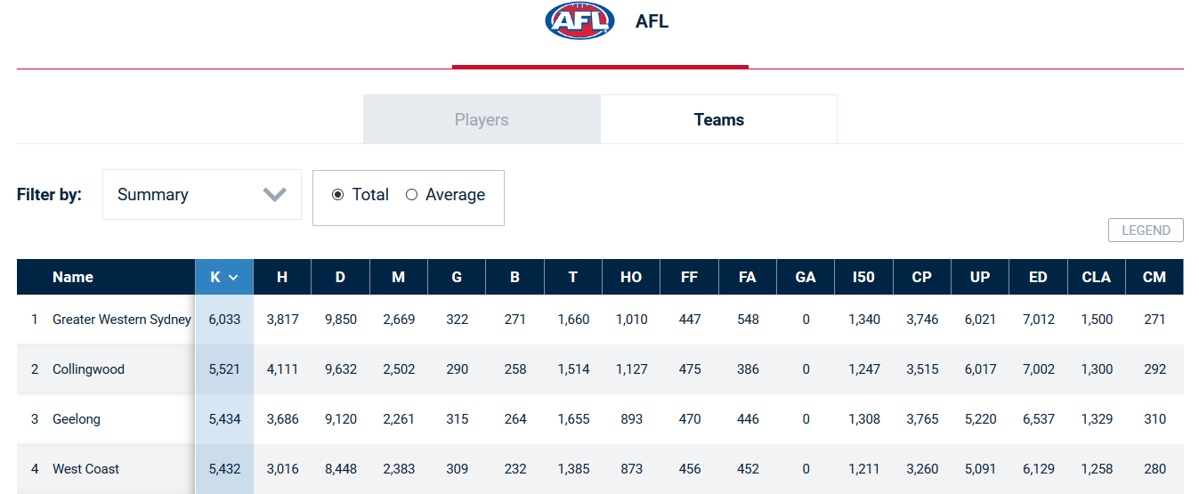
Business Analytics – Context
https://www.foxsports.com.au/afl/stats/teams
Notes:
INSTRUCTIONS
1. Delete blue box.
2. Then click icon, bottom left, to insert image.

Slide 13
Business Analytics – Data
Australia - Data.gov.au - https://data.gov.au/
US – Data.gov https://www.data.gov/
I Teach Accounting https://iteachaccounting.com/
Notes:
INSTRUCTIONS
1. Delete blue box.
2. Then click icon, bottom left, to insert image.

Slide 14
Business Analytics – Analysis
Tableau - https://www.tableau.com
Power BI - https://powerbi.microsoft.com/
QlikView - https://www.qlik.com
SAP - https://www.sap.com
SAS - https://www.sas.com
R - https://www.r-project.org/
Python - https://www.python.org/
Analytics tools

Slide 15
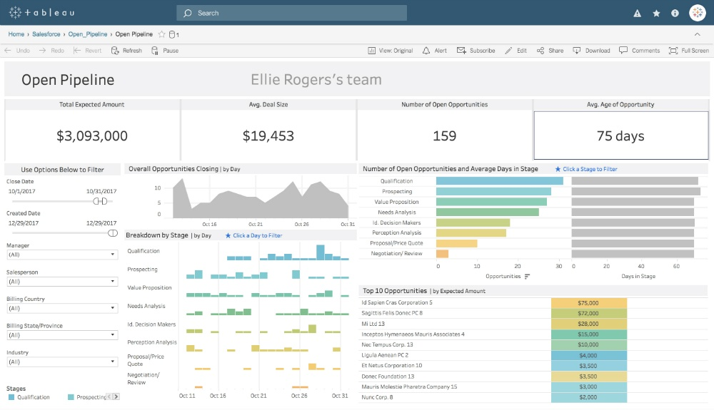
Business Analytics – Communication
https://www.canva.com
Notes:
INSTRUCTIONS
1. Delete blue box.
2. Then click icon, bottom left, to insert image.

Slide 16
Business Analytics – Influence
“Exploiting vast new flows of information can radically improve your company’s performance. But first you’ll have to change your decision-making culture.”
(McAfee and Brynjolfsson, 2012)
Notes:
INSTRUCTIONS
1. Delete blue box.
2. Then click icon, bottom left, to insert image.

Slide 17
Business Analytics
Context
Communicate
Analysis
Data
Question – What should we focus on?
Notes:
INSTRUCTIONS
1. Delete blue box.
2. Then click icon, bottom left, to insert image.

Slide 18
Accounting Curriculum – UTS
Financial Accounting
Accounting Standards & Regulations
Accounting for Business Combinations
Management Accounting
Cost Management Systems
Management Decisions and Control
Law
Applied Company Law
Taxation Law
Question – Should analytics be embedded or stand-alone?
Audit
Assurance Services and Audit
Accounting
Financial Statement Analysis
Financial Statement Analysis (capstone)

Slide 19
Resources
“HBR Guide to – Data Analytics Basics for Managers”
“Managerial Analytics” Michael Watson and Derek Nelson
“Business Analytics” Jeffrey Camm et al.

