Slide 1
Financial Accounting Standards and the Conceptual Framework
AFAANZ - 2019
Wayne Landsman
University of North Carolina at Chapel Hill
Kenan-Flagler Business School

Slide 2
Financial Accounting Standards and the Conceptual Framework
Objective
  Provide financial information about the reporting entity that is useful to existing and potential investors, lenders, and other creditors in making decisions about providing resources to the entity.
Notes:
________________________________________________________________
________________________________________________________________
________________________________________________________________
________________________________________________________________
________________________________________________________________
________________________________________________________________
________________________________________________________________
________________________________________________________________
________________________________________________________________
________________________________________________________________
________________________________________________________________
________________________________________________________________
________________________________________________________________
________________________________________________________________
________________________________________________________________
________________________________________________________________

Slide 3
Financial Accounting Standards and the Conceptual Framework
Qualitative characteristics of Useful Financial Information
  Financial information must be relevant and
  Faithfully represent what it purports to represent.
The usefulness of financial information is enhanced if it is
  Comparable
  Verifiable
  Timely
  Understandable.
Notes:
________________________________________________________________
________________________________________________________________
________________________________________________________________
________________________________________________________________
________________________________________________________________
________________________________________________________________
________________________________________________________________
________________________________________________________________
________________________________________________________________
________________________________________________________________
________________________________________________________________
________________________________________________________________
________________________________________________________________
________________________________________________________________
________________________________________________________________
________________________________________________________________

Slide 4
Financial Accounting Standards and the Conceptual Framework
Elements of Financial Statements
  Assets
  Liabilities
  Equity or net assets
  Comprehensive Income
  Revenues
  Expenses
  Gains
  Losses
Notes:
________________________________________________________________
________________________________________________________________
________________________________________________________________
________________________________________________________________
________________________________________________________________
________________________________________________________________
________________________________________________________________
________________________________________________________________
________________________________________________________________
________________________________________________________________
________________________________________________________________
________________________________________________________________
________________________________________________________________
________________________________________________________________
________________________________________________________________
________________________________________________________________

Slide 5
Case 1: Employee stock options
Case 1, Employee stock options (ESO)
  IFRS 2 and SFAS 123
Landsman, Wayne R., et al. "Which approach to accounting for employee stock options best reflects market pricing?." Review of Accounting Studies (2006).
Notes:
________________________________________________________________
________________________________________________________________
________________________________________________________________
________________________________________________________________
________________________________________________________________
________________________________________________________________
________________________________________________________________
________________________________________________________________
________________________________________________________________
________________________________________________________________
________________________________________________________________
________________________________________________________________
________________________________________________________________
________________________________________________________________
________________________________________________________________
________________________________________________________________

Slide 6
Case 1: Employee stock options
APB 25 “do nothing” method:
At exercise:
Dr. Cash
Cr. Stock, Par value (PAR)
Cr. Additional Paid in Capital (APIC) OR
Cr. Treasury shares (TIC)
Notes:
________________________________________________________________
________________________________________________________________
________________________________________________________________
________________________________________________________________
________________________________________________________________
________________________________________________________________
________________________________________________________________
________________________________________________________________
________________________________________________________________
________________________________________________________________
________________________________________________________________
________________________________________________________________
________________________________________________________________
________________________________________________________________
________________________________________________________________
________________________________________________________________

Slide 7
Case 1: Employee stock options
Exposure draft method:
Grant date:
Dr. ESO Asset (Intangible asset)
Cr. Equity (PIC – ESO’s)
Throughout vesting period:
Dr. ESO compensation expense
Cr. ESO Asset
At exercise:
Dr. Cash
Dr. PIC – ESOs
Cr. Par, APIC (or TS)
Notes:
________________________________________________________________
________________________________________________________________
________________________________________________________________
________________________________________________________________
________________________________________________________________
________________________________________________________________
________________________________________________________________
________________________________________________________________
________________________________________________________________
________________________________________________________________
________________________________________________________________
________________________________________________________________
________________________________________________________________
________________________________________________________________
________________________________________________________________
________________________________________________________________

Slide 8
Case 1: Employee stock options
FAS 123R/IFRS 2:
Grant date:
Do nothing
Throughout vesting period:
Dr. ESO compensation expense
Cr. PIC - ESOs
At exercise:
Dr. Cash
Dr. PIC – ESOs
Cr. Par, APIC (or TS)
Notes:
________________________________________________________________
________________________________________________________________
________________________________________________________________
________________________________________________________________
________________________________________________________________
________________________________________________________________
________________________________________________________________
________________________________________________________________
________________________________________________________________
________________________________________________________________
________________________________________________________________
________________________________________________________________
________________________________________________________________
________________________________________________________________
________________________________________________________________
________________________________________________________________

Slide 9
Case 1: Employee stock options
Asset and liability method:
Grant date:
Dr. ESO Asset (Intangible asset)
Cr. ESO Liability
Throughout vesting period:
Dr. ESO compensation expense
Cr. ESO Asset
AND
Dr. Loss
Cr. ESO Liability
Dr. ESO Liability
Cr. Gain
OR
Notes:
________________________________________________________________
________________________________________________________________
________________________________________________________________
________________________________________________________________
________________________________________________________________
________________________________________________________________
________________________________________________________________
________________________________________________________________
________________________________________________________________
________________________________________________________________
________________________________________________________________
________________________________________________________________
________________________________________________________________
________________________________________________________________
________________________________________________________________
________________________________________________________________

Slide 10
Case 1: Employee stock options
Asset and liability method:
At exercise:
Dr. Cash
Dr. ESO Liability
Cr. Par, APIC (or TS)*
* Will be recognized at FV because ESO liability is at FV
Notes:
________________________________________________________________
________________________________________________________________
________________________________________________________________
________________________________________________________________
________________________________________________________________
________________________________________________________________
________________________________________________________________
________________________________________________________________
________________________________________________________________
________________________________________________________________
________________________________________________________________
________________________________________________________________
________________________________________________________________
________________________________________________________________
________________________________________________________________
________________________________________________________________

Slide 11
Case 2: Leases
Case 2, Leases
  SFAS 13, ASC 842, and IFRS 16
Bowman, Robert G. "The debt equivalence of leases: An empirical investigation." Accounting Review (1980).
Notes:
________________________________________________________________
________________________________________________________________
________________________________________________________________
________________________________________________________________
________________________________________________________________
________________________________________________________________
________________________________________________________________
________________________________________________________________
________________________________________________________________
________________________________________________________________
________________________________________________________________
________________________________________________________________
________________________________________________________________
________________________________________________________________
________________________________________________________________
________________________________________________________________

Slide 12
Case 2: Leases
Requirements for capital lease treatment:
Capital lease treatment is required if the lease is noncancelable and at least one of the four conditions is met:
  The lease transfers ownership to the lessee.
  The lease contains a bargain purchase option.
  The lease term is equal to 75% or more of the estimated useful life of the leased asset.
  The present value of the minimum lease payments equals or exceeds 90% of the fair value of the leased property.
Notes:
________________________________________________________________
________________________________________________________________
________________________________________________________________
________________________________________________________________
________________________________________________________________
________________________________________________________________
________________________________________________________________
________________________________________________________________
________________________________________________________________
________________________________________________________________
________________________________________________________________
________________________________________________________________
________________________________________________________________
________________________________________________________________
________________________________________________________________
________________________________________________________________

Slide 13
Case 2: Leases
Spencer and Webb (2015) cites an SEC study from 2005 that notes the following:
“estimated that while 22 percent of issuers report capital leases totaling approximately $45 billion (undiscounted), 63 percent of issuers report off-balance sheet operating leases totaling approximately $1.25 trillion (undiscounted).”
Spencer, Angela Wheeler, and Thomas Z. Webb. "Leases: A review of contemporary academic literature relating to lessees." Accounting Horizons (2015).
Notes:
________________________________________________________________
________________________________________________________________
________________________________________________________________
________________________________________________________________
________________________________________________________________
________________________________________________________________
________________________________________________________________
________________________________________________________________
________________________________________________________________
________________________________________________________________
________________________________________________________________
________________________________________________________________
________________________________________________________________
________________________________________________________________
________________________________________________________________
________________________________________________________________

Slide 14
Case 2: Leases
Notes:
________________________________________________________________
________________________________________________________________
________________________________________________________________
________________________________________________________________
________________________________________________________________
________________________________________________________________
________________________________________________________________
________________________________________________________________
________________________________________________________________
________________________________________________________________
________________________________________________________________
________________________________________________________________
________________________________________________________________
________________________________________________________________
________________________________________________________________
________________________________________________________________

Slide 15
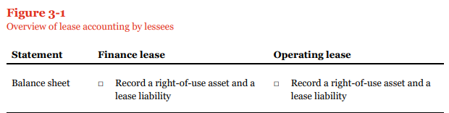
Case 2: Leases
https://www.pwc.com/us/en/cfodirect/assets/pdf/accounting-guides/pwc-lease-accounting-guide.pdf
Notes:
________________________________________________________________
________________________________________________________________
________________________________________________________________
________________________________________________________________
________________________________________________________________
________________________________________________________________
________________________________________________________________
________________________________________________________________
________________________________________________________________
________________________________________________________________
________________________________________________________________
________________________________________________________________
________________________________________________________________
________________________________________________________________
________________________________________________________________
________________________________________________________________

Slide 16

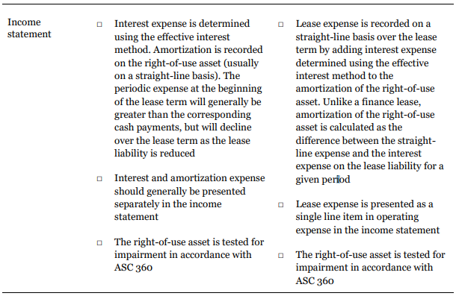
Case 2: Leases
Notes:
________________________________________________________________
________________________________________________________________
________________________________________________________________
________________________________________________________________
________________________________________________________________
________________________________________________________________
________________________________________________________________
________________________________________________________________
________________________________________________________________
________________________________________________________________
________________________________________________________________
________________________________________________________________
________________________________________________________________
________________________________________________________________
________________________________________________________________
________________________________________________________________

Slide 17
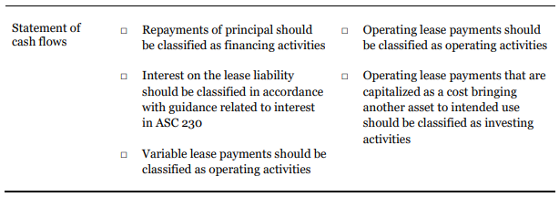
Case 2: Leases
Notes:
________________________________________________________________
________________________________________________________________
________________________________________________________________
________________________________________________________________
________________________________________________________________
________________________________________________________________
________________________________________________________________
________________________________________________________________
________________________________________________________________
________________________________________________________________
________________________________________________________________
________________________________________________________________
________________________________________________________________
________________________________________________________________
________________________________________________________________
________________________________________________________________

Slide 18
Case 3: Asset securitizations
Case 3, Asset securitizations
  SFAS 144, 166, IAS 39, and SIC 12
Notes:
________________________________________________________________
________________________________________________________________
________________________________________________________________
________________________________________________________________
________________________________________________________________
________________________________________________________________
________________________________________________________________
________________________________________________________________
________________________________________________________________
________________________________________________________________
________________________________________________________________
________________________________________________________________
________________________________________________________________
________________________________________________________________
________________________________________________________________
________________________________________________________________

Slide 19
Case 3: Asset securitizations
Transfer to entity unrelated to the firm (record as sale):
Dr. Cash
Cr. Transferred assets
Cr. Gain (or Dr. Loss)
Transfer to entity controlled by the firm (record as loan):
Dr. Cash
Cr. Debt
Notes:
________________________________________________________________
________________________________________________________________
________________________________________________________________
________________________________________________________________
________________________________________________________________
________________________________________________________________
________________________________________________________________
________________________________________________________________
________________________________________________________________
________________________________________________________________
________________________________________________________________
________________________________________________________________
________________________________________________________________
________________________________________________________________
________________________________________________________________
________________________________________________________________

Slide 20
Case 3: Asset securitizations
US Rules Before the Financial Crisis (BFC)
Sale accounting permitted if:
S-O legally relinquished control (title transfer and no explicit repurchase agreements)
SPE had at least 3% equity
S-O owned less than a majority stake in the equity
Notes:
________________________________________________________________
________________________________________________________________
________________________________________________________________
________________________________________________________________
________________________________________________________________
________________________________________________________________
________________________________________________________________
________________________________________________________________
________________________________________________________________
________________________________________________________________
________________________________________________________________
________________________________________________________________
________________________________________________________________
________________________________________________________________
________________________________________________________________
________________________________________________________________

Slide 21
Case 3: Asset securitizations
Landsman, Peasnell, and Shakespeare (TAR 2008) finds evidence that investors value S-O bank equity as if SPE assets and liabilities are assets and liabilities of the bank.
Landsman, Wayne R., Kenneth V. Peasnell, and Catherine Shakespeare. "Are asset securitizations sales or loans?." The Accounting Review (2008).
Notes:
________________________________________________________________
________________________________________________________________
________________________________________________________________
________________________________________________________________
________________________________________________________________
________________________________________________________________
________________________________________________________________
________________________________________________________________
________________________________________________________________
________________________________________________________________
________________________________________________________________
________________________________________________________________
________________________________________________________________
________________________________________________________________
________________________________________________________________
________________________________________________________________

Slide 22
Case 3: Asset securitizations
After Financial Crisis:
“Qualified” SPEs effectively eliminated. Effectively, this means that many more SPEs’ accounts must be consolidated with S-Os’.
Tightens up consolidation requirements for Variable Interest Entities (an SPE structure).
Notes:
________________________________________________________________
________________________________________________________________
________________________________________________________________
________________________________________________________________
________________________________________________________________
________________________________________________________________
________________________________________________________________
________________________________________________________________
________________________________________________________________
________________________________________________________________
________________________________________________________________
________________________________________________________________
________________________________________________________________
________________________________________________________________
________________________________________________________________
________________________________________________________________

Slide 23
Case 3: Asset securitizations
After Financial Crisis:
Additional disclosures are required by the S-O, including
Nature and purpose of SPE or VIE.
Whether changes in financing of SPE by S-O have occurred subsequent to set-up of SPE.
Fair value of financial assets and liabilities of SPE.
Arrangements that could require the S-O to provide financial support to VIE, including events or circumstances that could expose the enterprise to a loss.
Consolidation rule changes went into effect 2010, but disclosures were required beginning 4th quarter 2008.
Notes:
________________________________________________________________
________________________________________________________________
________________________________________________________________
________________________________________________________________
________________________________________________________________
________________________________________________________________
________________________________________________________________
________________________________________________________________
________________________________________________________________
________________________________________________________________
________________________________________________________________
________________________________________________________________
________________________________________________________________
________________________________________________________________
________________________________________________________________
________________________________________________________________

Slide 24
THANK YOU!

